Slide 1
Red Hat Ansible Aotomation Platform
Febuary 09, 2022
Shadd Galleos

Slide 2
Agenda
Introductions
Ansible Essentials
Ansible Automation Solutions
Summary & Next Steps

Slide 3

Your Presenter
Shadd Gallegos
Ansible Solutions Architect
shadd@redhat.com

Slide 4
What is Ansible?
The means to automate the Enterprise
Ansible is a automation engine for use with multiple platforms, multiple tiers, and to address multiple use cases.
Ansible is:
Agentless
Easy to deploy
Uses a universal, human-readable language: YAML
No special coding skills needed
Plain text and spaces

Slide 5










Automate the deployment and management of automation
Why the Red Hat Ansible Automation Platform?
Your entire IT footprint
Do this...
Orchestrate
Manage configurations
Deploy applications
Provision / deprovision
Deliver continuously
Secure and comply
On these...
Firewalls
Load balancers
Applications
Containers
Virtualization platforms
Servers
Clouds
Storage
Network devices
And more ...
Notes:
What does that mean in tangible detail? What can you really do with the Ansible Automation Platform?
A lot, and across multiple domains:
Orchestrate fleets of VMs across the open hybrid cloud
Manage the configuration of networking devices across data centers
Enable application deployment to integrate load balancer changes and CMDB configuration
Enable developers to provision their own storage objects in an automated fashion when needed
Embed the automated configuration of external services into the CI/CD pipeline
Integrate firewalls with intrusion detection systems into streamlined security remediation workflows
Manage the lifecycle of existing applications and infrastructure, updating applications and hardware in streamlined processes

Slide 6
Ansible automates technologies you use Time to automate is measured in minutes, 50+ certified platforms
Cloud
Virt & Container
Windows
Network
Security
Monitoring
AWS
Azure
Digital Ocean
Google
OpenStack
Rackspace
+more
Docker
Kubernetes
OpenStack
OpenShift
VMware
+more
ACLs
Files
Packages
IIS
Registry
Shares
Services
Configs
Users
Domains
Updates
+more
Arista
Aruba
Bigswitch
Cisco
Ericsson
F5
FRR
Juniper
Meraki
OpenvSwitch
Ruckus
VyOS
+more
Checkpoint
Cisco
CyberArk
F5
Fortinet
Juniper
IBM
Palo Alto
Snort
+more
Dynatrace
Datadog
LogicMonitor
New Relic
Sensu
+more
Devops
Jira
GitHub
Vagrant
Jenkins
Slack
+more
Red Hat Products
RHEL
OpenShift
Satellite
Insights
PAM/DM
JBoss EAP
+more
Storage
EMC
Netapp
Hitachi
IBM
Infinidat
+more
Systems
IBM (Z,P,I)
Dell
Cisco
HP
Notes:
Ansible’s agentless architecture provides enablement for a wide variety of platforms that make it easy for them to be automated. With the move to Content Collections, it’s now even easier for the partners and community to build, test, and publish content at any time without the wait for it to be included in an actual Ansible release. Ansible Galaxy is the de-facto place for community content, while Automation Hub is the place for Certified content (selected certified platforms in bold, many more available).
Uses OpenSSH and WinRM
No agents to exploit or update
Predictable, reliable and secure
Ansible automates technologies you already use
With the power of a community behind it generating more integrations every day
----------------------------------------------------------------
Points Tim Yeaton added here in his delivery:
Communities of partners building around our language
Tremendous adoption to date - realization in order to scale you have to automate

Slide 7
Why use Ansible?
The means to automate the Enterprise
Ansible’s key features:
Infrastructure as Code
Universal automation platform
Delivers a documented, deterministic process
Idempotence is fundamental
Facilitates uniformity, enables continuous delivery

Slide 8
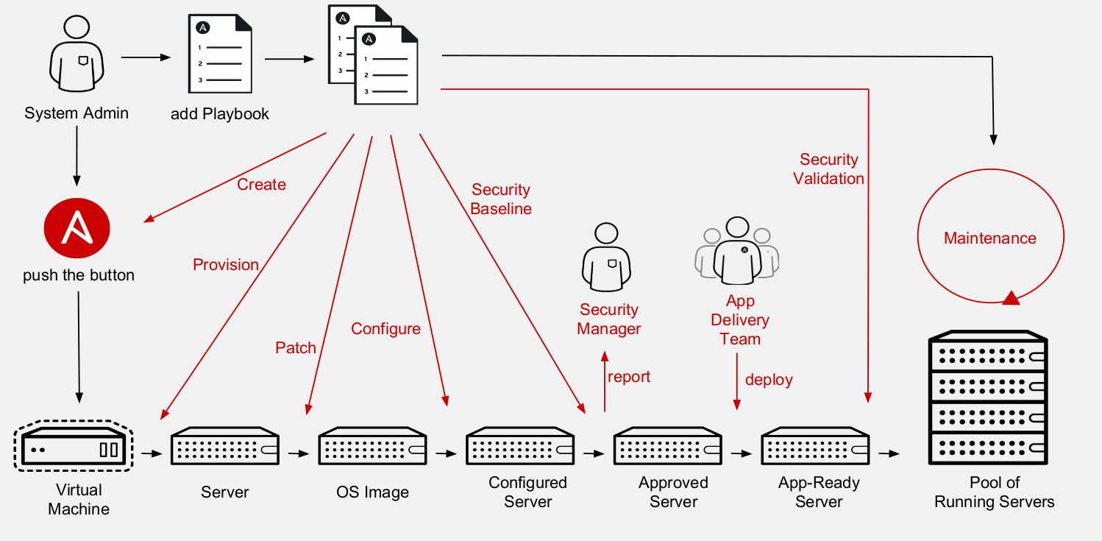
Nothing Routine Should be Done Manually

Slide 9
Key Ansible Terms and Components
Inventory - a list of target devices for an Ansible operation
Fact - Information fetched from the client systems from the global variables via Ansible’s gather-facts function.
Playbook - the scripted procedure, mostly comprised of Tasks, Modules, and Roles
Module - a command or set of similar Ansible commands meant to be executed on the client
Task - a section of a playbook consisting of a single procedure
Role - a way of organizing tasks and related files to be called in a playbook
Collection - a distribution format for Ansible content that can include playbooks, roles, modules, and plugins
Notes:
These are commonly used ansible terms that I want to introduce early in our discussion. Shadd’s presentation will explain a bit more about each term and its features.

Slide 10
A Simple Ansible Playbook
---
- name: install and start apache
hosts: webservers
become: yes
tasks:
- name: httpd package is present
yum:
name: httpd
state: latest
- name: latest index.html file is present
template:
src: files/index.html
dest: /var/www/html/
- name: httpd is started
service:
name: httpd
state: started
Notes:
Let’s cover some of the introductory concepts of Ansible Automation. An Ansible Playbook is analogous to a shell script - it defines the complete procedure to accomplish the desired outcome. In this example we notice the hosts: entry defines the list of hosts upon which this procedure will operate, which we call the inventory. This sample playbook contains a tasks: entry defining a specific procedure. The yum: entry refers to a frequently-used Ansible module used to add/remove/edit RPM packages using the yum command - the same module name as the command makes it easy to recall. Template and service are also Ansible module.

Slide 11
Ansible Inventory Example
nsblde9 ansible_port=22 ansible_user=cgeboers
nsblde6 ansible_host=nsblde6.atc-hp.com ansible_port=22 ansible_user=corg
nsx09 ansible_host=nsx09.atc-hp.com ansible_port=22 ansible_user=corg
[webservers]
nsblde9 ansible_host=nsblde9.atc-hp.com ansible_port=22 ansible_user=cgeboers
nsx09 ansible_host=nsx09.atc-hp.com ansible_port=22 ansible_user=corg

Slide 12
A Playbook Example for NonStop
---
- hosts: webservers
tasks:
- name: Check if distribution is already on system
stat: path="{{ dist_folder }}/{{ itp_version }}"
register: sym
- name: Unpack iTP Webserver archive
command: "/bin/pax -r -s:/usr/tandem/webserver:{{ dist_folder }}: -s:/usr/lib:{{ dist_folder }}/lib:
-s:/usr/include:{{ dist_folder }}/include: -f /G/system/zossutl/t8996pax"
when: sym.stat.islnk is not defined
- name: Setup answer file
template: src=templates/itpwebserver_setup.sh.j2
dest={{ dist_folder }}/itpwebserver_setup.sh
mode="u=rwx,g=rx,o=rx"
- name: Install iTP Webserver
command: "{{ dist_folder }}/itpwebserver_setup.sh"

Slide 13
Ansible References
Red Hat Ansible Training and Hands-on Labs
Get Started with Ansible
Ansible Basics Video Training
Free Self-Paced Ansible Hands-on Labs

Slide 14
Thank You!
Eric Macha - Account Executive
eric.macha@redhat.com
Robert Proffitt - Solution Architect
robertp@redhat.com
Shadd Gallegos - Automation Solution Architect
shadd@redhat.com

